Slide 1
Microscopic Ohm’s Law
Outline
Semiconductor Review
Electron Scattering and Effective Mass
Microscopic Derivation of Ohm’s Law

Slide 2
TRUE / FALSE
Judging from the filled
bands, material A is an
insulator.
2. Shining light on a semiconductor should decrease its resistance.
3. The band gap is a certain location in a semiconductor that electrons are forbidden to enter.
A
B

Slide 3
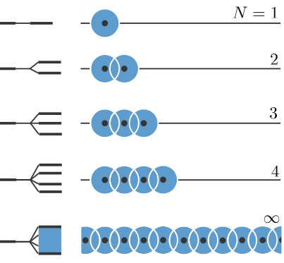
1-D Lattice of Atoms
Single orbital, single atom basis
Adding atoms…
  reduces curvature of lowest energy state (incrementally)
  increases number of states (nodes)
  beyond ~10 atoms the bandwidth does not change with crystal size
Decreasing distance between atoms (lattice constant) …
  increases bandwidth

Slide 4
From Molecules to Solids
N-1 nodes
N atoms N states
0 nodes
Closely spaced energy levels form a “band” of energies between the max and min energies

Slide 5
Electron Wavepacket in Periodic Potential
Electron wavepacket
Coulomb potential due to nuclei
For smooth motion
  wavepacket width >> atomic spacing
  any change in lattice periodicity ‘scatters’ wavepacket
  - vibrations
  - impurities (dopants)

Slide 6
Equivalent Free Particle
Electron wavepacket
Effective ‘free’ electron wavepacket
Coulomb potential due to nuclei
Wavepacket moves as if it had an effective mass…
Electron responds to external force as if it had an effective mass

Slide 7
Surprise: Effective Mass for Semiconductors
Electrons wavepackets
often have effective mass smaller than free electrons !
Name | Symbol | Germanium | Silicon | Gallium Arsenide
Smallest energy bandgap at 300 K | E_{g} (eV) | 0.66 | 1.12 | 1.424
Effective mass for conductivity calculations
Electrons | m_{e}*_{,cond}/m₀ | 0.12 | 0.26 | 0.067
Holes | m_{h}*_{,cond}/m₀ | 0.21 | 0.36 | 0.34
Which material will make faster transistors ?

Slide 8
Approximate Wavefunction for 1-D Lattice
Single orbital, single atom basis
k = 0
a
(crystal lattice spacing)
k ≠ 0
k = π/a
k is a convenient way to enumerate the different energy levels
(count the nodes)
Bloch Functions:

Slide 9
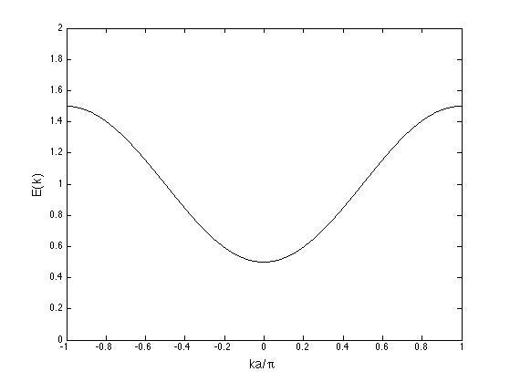
Energy Band for 1-D Lattice
Single orbital, single atom basis
highest energy (most nodes)
lowest energy (fewest nodes)
Number of states in band = number of atoms
Number of electrons to fill band = number of atoms x 2 (spin)

Slide 10
From Molecules to Solids
r
2s energy
n = 2
1s energy
n = 1
N states
N states
Bands of “allowed” energies
for electrons
Bands Gap – range of energy where there are no “allowed states”
The total number of states = (number of atoms) x (number of orbitals in each atom)

Slide 11
Bands from Multiple Orbitals
Atom
Solid
Example of Na
+e
r
Z = 11 1s²2s²2p⁶3s¹
Image in the Public Domain
n = 3
n = 2
n = 1
These two facts
are the basis for our understanding of metals, semiconductors, and insulators !!!
Each atomic state → a band of states in the crystal
These are the “allowed” states for electrons in the crystal
→ Fill according to Pauli Exclusion Principle
There may be gaps between the bands
These are “forbidden”energies where there
are no states for electrons
What do you expect to be a metal ?
Na? Mg? Al? Si? P?
Notes:
11

Slide 12
What about semiconductors like silicon?
Fill the Bloch states according to Pauli Principle
Z = 14 1s²2s²2p⁶3s²3p²
Total # atoms = N
Total # electrons = 14N
3s, 3p
4N states
2s, 2p
4N states
1s
N states
2N electrons fill these states
8N electrons fill these states
It appears that, like Na, Si will also have a half filled band: The 3s3p band has 4N orbital states and 4N electrons.
By this analysis, Si should be a good metal, just like Na.
But something special happens for Group IV elements.

Slide 13
Silicon Bandgap
Fill the Bloch states according to Pauli Principle
Z = 14 1s²2s²2p⁶3s²3p²
Total # atoms = N
Total # electrons = 14N
3s, 3p
4N states
2s, 2p
4N states
1s
N states
2N electrons fill these states
8N electrons fill these states
The 3s-3p band
splits into two:
Antibonding states
Bonding states

Slide 14
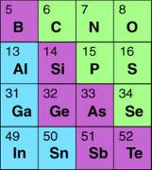
Controlling Conductivity: Doping Solids
Silicon crystal
Silicon crystal
Extra
electron
Conduction
Band
(Unfilled)
Conduction
Band
(partially filled)
Valence
Band
(filled)
Valence
Band
(partially filled)
Boron atom (5)
hole
IIIA
IVA
VA
VIA
Arsenic atom (33)
ACCEPTOR DOPING:
P-type Semiconductor
Dopants: B, Al
DONOR DOPING
N-type Semiconductor
Dopants: As, P, Sb
Image in the
Public Domain

Slide 15
Making Silicon Conduct
Metal
Insulator
or
Semiconductor
T=0
Semi-
Conductor
T≠0
n-Doped
Semi-
Conductor

Slide 16


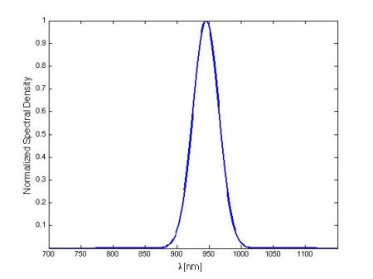

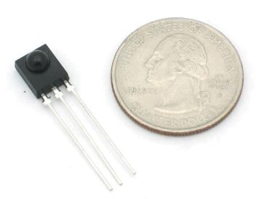
Today’s Culture Moment
Energy
The bandgap in Si is 1.12 eV at room temperature. What is “reddest” color (the longest wavelength) that you could use to excite an electron to the conduction band?
Conduction Band
Electron
Hole
Valence Band
Typical IR remote control
Image is in the public domain
Image is in the public domain
IR detector

Slide 17
Semiconductor Resistor
Given that you are applying a constant E-field (Voltage) why do you get a fixed velocity (Current) ? In other words why is the Force proportional to Velocity ?
I
l
n
A
V
How does the resistance depend on geometry ?

Slide 18
Microscopic Scattering
A local, unexpected change in V(x) of electron as it approaches the impurity
Strained region
by impurity exerts a scattering force
Scattering from thermal vibrations

Slide 19
Microscopic Transport
v
v_{d}
t
Balance equation for forces on electrons:
Drag Force
Lorentz Force

Slide 20
Microscopic Variables for Electrical Transport
Drude Theory
Balance equation for forces on electrons:
Drag Force
Lorentz Force
In steady-state when B=0:
Note: Inside a semiconductor m = m* (effective mass of the electron)
and

Slide 21
Semiconductor Resistor
and
Recovering macroscopic variables:
Start
OHM’s LAW
Finish

Slide 22
Microscopic Variables for Electrical Transport
Start
and
Finish
For silicon crystal doped at n = 10¹⁷ cm⁻³ :
σ = 11.2 (Ω cm)⁻¹ , μ = 700 cm²/(Vs)and m* = 0.26 m_{o}
At electric fields of E = 10⁶ V/m = 10⁴ V/cm,
v = μE = 700 cm²/(Vs) * 10⁴ V/cm = 7 x 10⁶ cm/s = 7 x 10⁴ m/s
scattering event every 7 nm ~ 25 atomic sites

Slide 23
Electron Mobility
Electron wavepacket
Electron velocity for a fixed applied E-field
Energy
Conduction Band
Change in periodic potential
Electron
Hole
Valence Band

Slide 24
Electron Mobility
Intrinsic Semiconductors
(no dopants)
  Dominated by number of carriers, which increases exponentially with increasing temperature due to increased probability of electrons jumping across the band gap
  At high enough temperatures phonon scattering dominates → velocity saturation
Metals
  Dominated by mobility, which decreases with increasing temperature

Slide 25
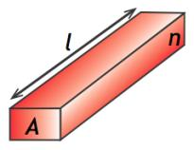
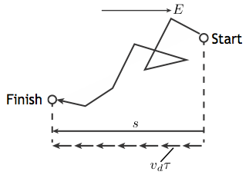
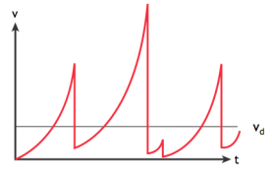
Key Takeaways
Electron wavepacket
Coulomb potential due to nuclei
Wavepacket moves as if it had an effective mass…

Slide 26
MIT OpenCourseWare
http://ocw.mit.edu
6.007 Electromagnetic Energy: From Motors to Lasers
Spring 2011
For information about citing these materials or our Terms of Use, visit: http://ocw.mit.edu/terms.

