Slide 1
Semiconductors
Outline
Crystals: Atomic Solids
Conductors and Insulators
Doped Semiconductors

Slide 2
Bonding Between Atoms
How can two neutral objects bind together?
H + H → H₂
-e
+e
Continuum of free electron states
Let’s represent the atom in space by its Coulomb potential centered on the proton (+e):
r
n = 3
n = 2
energy of -e
n = 1
+e
+e
+e
Continuum of free electron states
-e
Superposition of Coulomb potentials H₂:
r
energy of -e
Notes:
2

Slide 3
Molecular Wavefunctions
+e
r
Atomic ground state:
(1s)
1s energy
n = 1
Molecular states:
+e
+e
+e
+e
r
r
1s energy
Bonding state Antibonding state

Slide 4
Tunneling Between Atoms in Solids
-e
+e
r
Again start with simple atomic state:
energy of -e
n = 1
Bring N atoms together together forming a 1-d crystal (a periodic lattice)…
-e
energy of -e

Slide 5
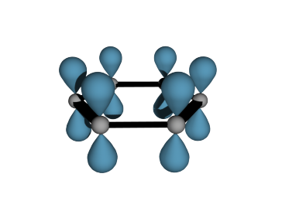
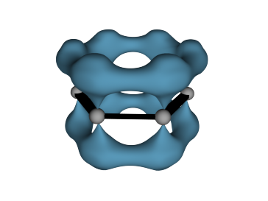
Let’s Take a Look at Molecular Orbitals of Benzene
… the simplest “conjugated alkene”
H
Typical C-C bond length 1.54 Å
Typical C=C bond length 1.33 Å
1.08 Å
H
C
H
C
C
or
1.395 Å
C
C
H
C
H
Length of benzene
carbon-carbon bonds is between
C-C and C=C bond lengths
H
p orbitals
π-electron density
© Source unknown. All rights reserved. This content is excluded from our Creative Commons license. For more information, see http://ocw.mit.edu/fairuse.

Slide 6
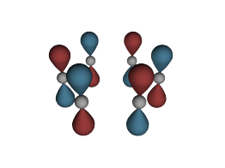
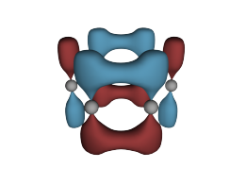
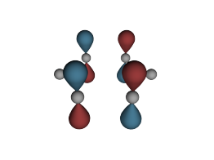
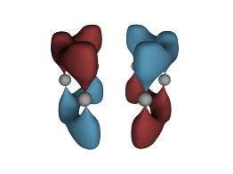
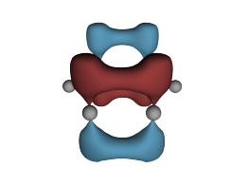
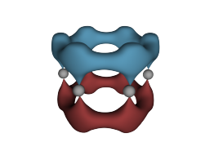
Molecular Orbitals of Benzene
ELECTRON ENERGY
ELECTRON ENERGY
ELECTRON ENERGY
Electron Energy
Energy distribution of
Benzene π-molecular orbitals
Carbon atoms are represented by dots
Nodal planes are represented by lines
© Source unknown. All rights reserved. This content is excluded from our CreativeCommons license. For more information, see http://ocw.mit.edu/fairuse.
antibonding MOs
energy of isolated
p-orbital
Energy
bonding MOs
from Loudon

Slide 7
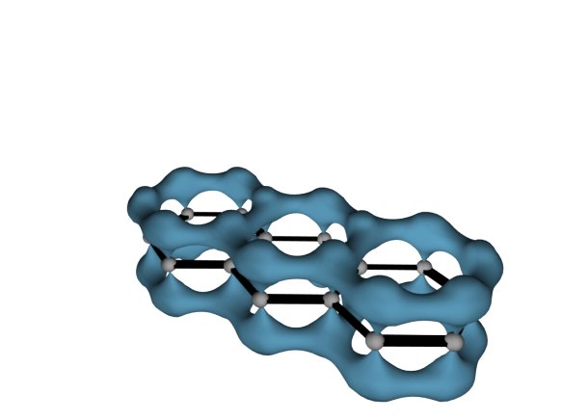
… More Examples – Series of Polyacene Molecules
Molecule
Absorption
The lowest bonding MO of anthracene
… LOWEST ENERGY ABSORPTION PEAK AT …
Benzene
Naphthaline
Anthracene
Tetracene
Pentacene
255 nm
315 nm
380 nm
480 nm
580 nm
© Source unknown. All rights reserved. This content is excluded from our CreativeCommons license. For more information, see http://ocw.mit.edu/fairuse.
496
397
330
283 (nm)
Red: bigger molecules !
Blue: smaller molecules !
20000
25000
30000
35000 cm⁻¹
Luminescence Spectra
ENERGY

Slide 8


From Molecules to Solids
0 nodes
1 node
0 nodes ………………… N-1 nodes
Number of atoms = number of states

Slide 9
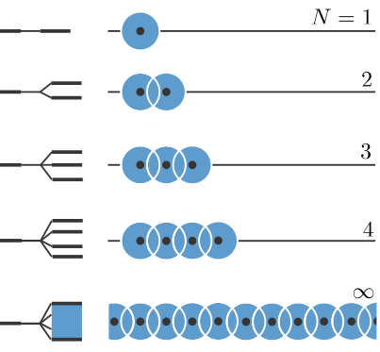
1-D Lattice of Atoms
Single orbital, single atom basis
Adding atoms…
  reduces curvature of lowest energy state (incrementally)
  increases number of states (nodes)
  beyond ~10 atoms the bandwidth does not change with crystal size
Decreasing distance between atoms (lattice constant) …
  increases bandwidth

Slide 10
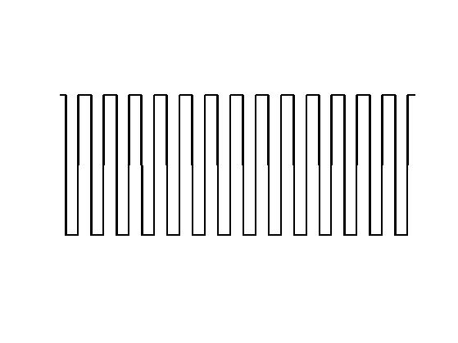
Consider a set of quantum wells

Slide 11
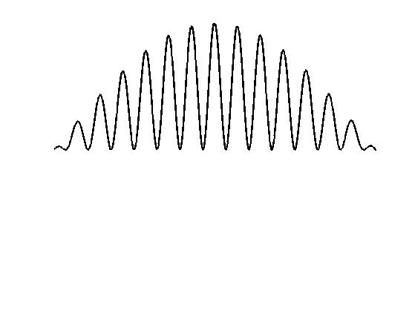
Ground state solution

Slide 12
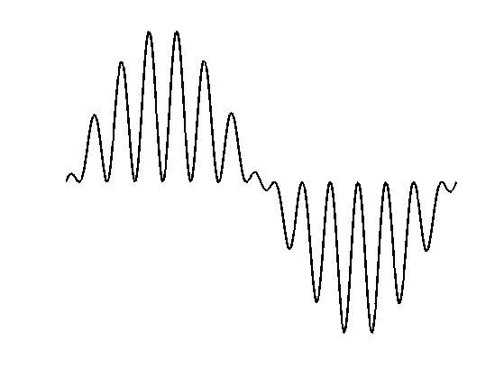
First excited state solution

Slide 13
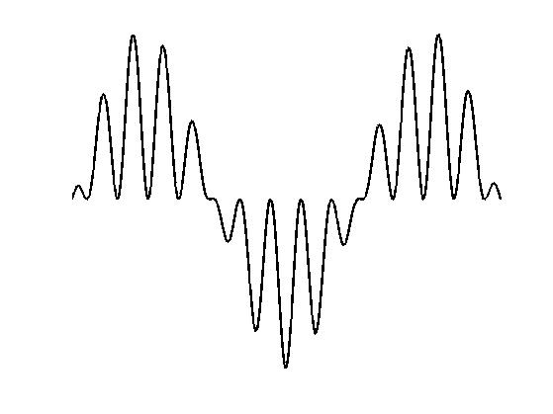
Second excited state solution

Slide 14
Interpretation of the Wavefunction Shapes
Envelope of wavefunction seems to work like wavefunction for a particle in a box
Wavefunctions local to a single well look like ground state wavefunction for a well in isolation
Same kind of effect occurs with atomic potentials instead of quantum well potentials

Slide 15
From Molecules to Solids
N-1 nodes
N atoms N states
0 nodes
Closely spaced energy levels form a “band” of energies between the max and min energies

Slide 16
Approximate Wavefunction for 1-D Lattice
Single orbital, single atom basis
k = 0
a
(crystal lattice spacing)
k ≠ 0
k = π/a
k is a convenient way to enumerate the different energy levels
(count the nodes)
Bloch Functions:

Slide 17
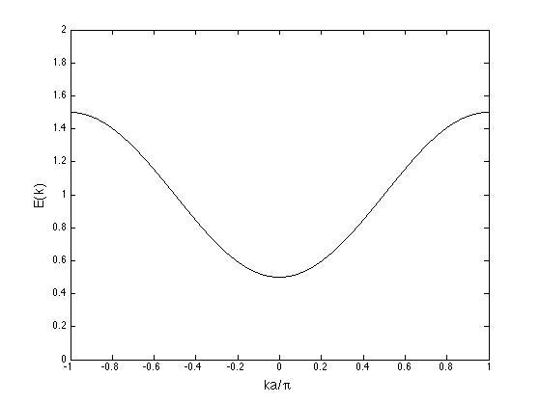
Energy Band for 1-D Lattice
Single orbital, single atom basis
highest energy (most nodes)
lowest energy (fewest nodes)
Number of states in band = number of atoms
Number of electrons to fill band = number of atoms x 2 (spin)

Slide 18
From Molecules to Solids
+e
r
2s energy
n = 2
1s energy
n = 1
N states
N states
Bands of “allowed” energies
for electrons
Bands Gap – range of energy where there are no “allowed states”
The total number of states = (number of atoms) x (number of orbitals in each atom)

Slide 19

Bands from Multiple Orbitals
Atom
Solid
Example of Na
+e
r
Z = 11 1s²2s²2p⁶3s¹
Image in the Public Domain
n = 3
n = 2
n = 1
These two facts
are the basis for our understanding of metals, semiconductors, and insulators !!!
Each atomic state → a band of states in the crystal
These are the “allowed” states for electrons in the crystal
→ Fill according to Pauli Exclusion Principle
There may be gaps between the bands
These are “forbidden”energies where there
are no states for electrons
What do you expect to be a metal ?
Na? Mg? Al? Si? P?
Notes:
19

Slide 20
What about semiconductors like silicon?
Fill the Bloch states according to Pauli Principle
Z = 14 1s²2s²2p⁶3s²3p²
Total # atoms = N
Total # electrons = 14N
3s, 3p
4N states
2s, 2p
4N states
1s
N states
2N electrons fill these states
8N electrons fill these states
It appears that, like Na, Si will also have a half filled band: The 3s3p band has 4N orbital states and 4N electrons.
By this analysis, Si should be a good metal, just like Na.
But something special happens for Group IV elements.

Slide 21
Silicon Bandgap
Fill the Bloch states according to Pauli Principle
Z = 14 1s²2s²2p⁶3s²3p²
Total # atoms = N
Total # electrons = 14N
3s, 3p
4N states
2s, 2p
4N states
1s
N states
2N electrons fill these states
8N electrons fill these states
The 3s-3p band
splits into two:
Antibonding states
Bonding states

Slide 22
Conduction and Band-filling
Metal
Insulator
The electrons in a filled band cannot contribute to conduction,
because with reasonable E fields they cannot be promoted to a higher kinetic energy.
Therefore, at T = 0, Si is an insulator. At higher temperatures, however, electrons are thermally promoted into the conduction band.

Slide 23
Electronic Conduction in a Semiconductor
- example: Si Z = 14 1s²2s²2p⁶3s²3p²
Electron States in Silicon
valence electrons
Empty band at T = 0. (Conduction Band)
3s/3p band
Energy Gap E_{gap} ≈ 1 eV
Filled band at T = 0 (Valence band)
The electrons in a filled band cannot contribute to conduction,
because with reasonable E fields they cannot be promoted to a higher kinetic energy.
Therefore, at T = 0, Si is an insulator. At higher temperatures, however, electrons are thermally promoted into the conduction band.

Slide 24
Making Silicon Conduct
Consider electrons in a semiconductor, e.g., silicon. In a perfect crystal at T=0 the valence bands are filled and the conduction bands are empty - no conduction. Which of the following could be done to make the material conductve?
a. heat the material
b. shine light on it
c. add foreign atoms that change the number of electrons
As we increase the temperature,
such that kT → E_{gap}, some electrons are excited to the conduction band
As we shine light on the material
(with energy E_{photon} > E_{gap}),
electron-hole pairs are created
“Donor” atoms (like P) have extra electrons to add to the crystal. The electrons are “donated” to the conduction band and they can conduct electricity.
“Acceptor” atoms (like B) have fewer electrons and they “accept” electrons from the crystal. This leaves missing electrons – called “holes” in the valence band so that it is not completely filled and can conduct electricity.

Slide 25
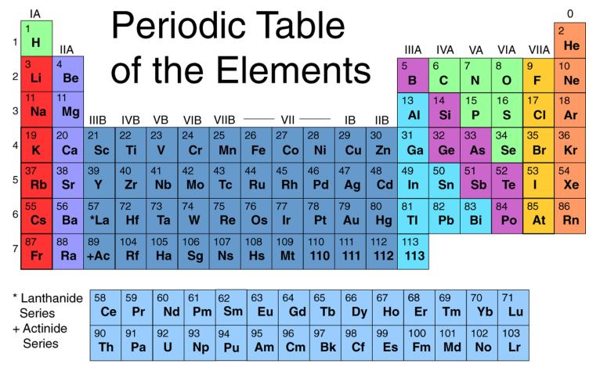
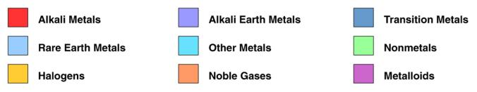
Images in the Public Domain

Slide 26
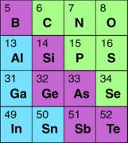
Controlling Conductivity: Doping Solids
Silicon crystal
Silicon crystal
Extra
electron
Conduction
Band
(Unfilled)
Conduction
Band
(partially filled)
Valence
Band
(filled)
Valence
Band
(partially filled)
Boron atom (5)
hole
IIIA
IVA
VA
VIA
Arsenic atom (33)
ACCEPTOR DOPING:
P-type Semiconductor
Dopants: B, Al
DONOR DOPING
N-type Semiconductor
Dopants: As, P, Sb
Image in the
Public Domain

Slide 27
Making Silicon Conduct
Metal
Insulator
or
Semiconductor
T=0
Semi-
Conductor
T≠0
n-Doped
Semi-
Conductor

Slide 28
Controlling Conductivity: Doping Solids
Adding impurities can change the conductivity from ‘insulator’ to ‘metal’
10⁴
Polyethylene
Glass
10²
Resistivity (Ω cm)
10⁰
Resistivity
Silicon
10⁻²
Copper
10⁻⁴
10¹²
10¹⁴
10¹⁶
10¹⁸
10²⁰
Concentration N(cm⁻³)
of dopant atoms in silicon
Note: Density of silicon atoms in a perfect (undoped) crystal of silicon is 5x10²² cm⁻³

Slide 29
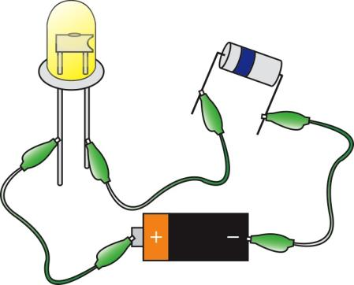
p-n Junctions and LEDs
p-type
n-type
LED
Resistor
Power Source
Resistor
Not
Shown
High energy electrons (n-type) fall into low energy holes (p-type)

Slide 30
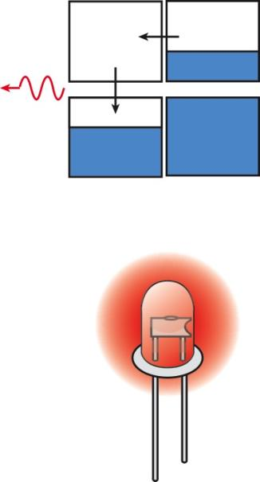
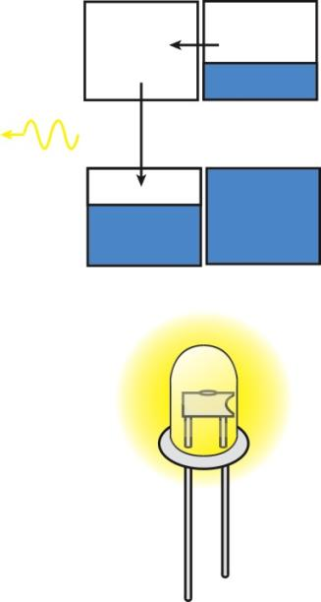
p-n Junctions and LEDs
Red
Light
Emitted
Yellow
Light
Emitted
Small Gap
ENERGY
Large Gap

Slide 31
 | Symbol | Band gap (eV) 300 K
 | InAs | 0.36
 | ZnO | 3.37
 | ZnS | 3.6
 | ZnSe | 2.7
 | ZnTe | 2.25
 | CdS | 2.42
 | CdSe | 1.73
 | CdTe | 1.49
 | PbS | 0.37
 | PbSe | 0.27
 | PbTe | 0.29
Bandgaps of Different Semiconductors
 | Symbol | Band gap (eV) 300 K
 | Si | 1.11
 | Ge | 0.67
 | SiC | 2.86
 | AlP | 2.45
 | AlAs | 2.16
 | AlSb | 1.6
 | AlN | 6.3
 | C | 5.5
 | GaP | 2.26
 | GaAs | 1.43
 | GaN | 3.4
 | GaS | 2.5 (@ 295 K)
 | GaSb | 0.7
 | InP | 1.35

Slide 32
MIT OpenCourseWare
http://ocw.mit.edu
6.007 Electromagnetic Energy: From Motors to Lasers
Spring 2011
For information about citing these materials or our Terms of Use, visit: http://ocw.mit.edu/terms.

