Slide 1
Light Reflectors and Optical Resonators
Outline
Review of Wave Reflection
Reflection and Interference
Fiber for Telecommunications
Optical Resonators

Slide 2
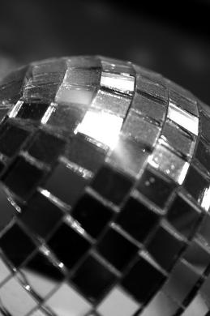
Reflection of a Normally Incident EM Wave from a Perfect Conductor
Standing wave
pattern
of the E-field
Image by Theogeo http://www.
flickr.com/photos/theogeo/1102
816166/ on flickr
Standing wave
pattern
of the H-field

Slide 3
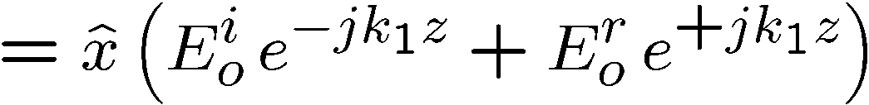
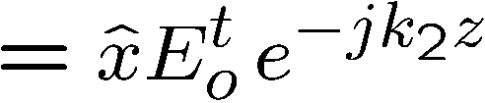
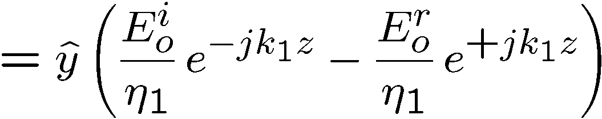
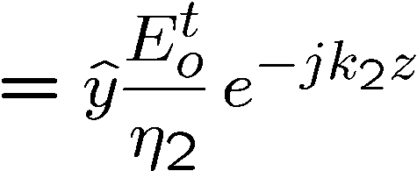
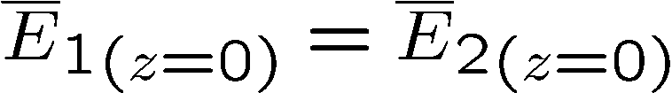
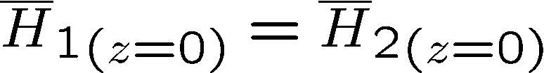
Reflection & Transmission of EM Waves at Boundaries
Medium 1
Medium 2

Slide 4
Reflection of EM Waves at Boundaries
REFLECTION COEFFICIENT
(note that sign of r depends on
the relative values of η₂ and η₁)
TRANSMISION COEFFICIENT

Slide 5
Examples of Light Reflection
MEDIUM 1
MEDIUM 2
The image below indicates the standing wave patterns ( ) resulting when an incident wave in medium 1 with amplitude equal to 1 V/m is incident on an interface. Label the graphs (a)-(g) to match them with the description detailed below.
2.0
c
2.0
a) Plot of with medium 1 being air, medium 2, n₂ =2. Normal incidence.
b) Plot of with medium 1 having n₁ = 2, medium 2 being air. Normal incidence.
c) Plot of with medium 1 being air, medium 2 being a perfect conductor
d) Plot of with medium 1 being air, medium 2 being a perfect conductor
e) Plot of with medium 1 having n₁ =2, medium 2 being air. Angle of incidence greater than critical angle.
f) Plot of with angle of incidence equal to the Brewster angle.
g) Plot of with angle of incidence equal to the Brewster angle. Medium 2 is air.
e
2.0
2.0
1.6
1.33
b
f
0.95
0.67
1.33
a
2.85
g
0.67
0.32
2.0
2.0
d

Slide 6
Remote Sensing of the Environment … using radar
EXAMPLE: MEASUREMENT OF THICKNESS OF POLAR ICE CAPS

Slide 7
Reflectometry
… measurement of distance to a target by
identifying the nodes in the standing wave pattern
transmitter
receiver
Conducting
surface

Slide 8

Today’s Culture Moment
Ice is more reflective than water
10% reflected by ocean water
20% reflected by vegetation
and dark soil
70-80% of sunlight
reflected by snow

Slide 9
The Greenhouse Effect
Sunlight is reradiated as heat and trapped by greenhouse gasses such as carbon dioxide. Too much carbon dioxide, however, causes the planet to heat up more than usual.
sunlight
heat
19°
18°
Future
Temperatures?
17°
Celsius
16°
57.97°F
56.79°F
15°
14°
13°
1880
1920
1960
2000
2040
2080
Year

Slide 10
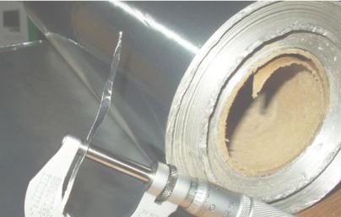
Deploy Aluminum Rafts over Dead Ocean Areas ?
Net excess energy input into planet Earth 1.6 W/m².
Illuminance on ground level is ~1000 W/m²
    We need to reflect 1.6/1000 of energy back to Balance the Energy IN/OUT
Oceans are 90% absorptive (10% reflective)
Aluminum is 88% reflective on the shiny side and 80% reflective on the dull side.
(Frosted silica might also be able to be used as a reflector)
How much of ocean area do we need to cover
with 80% reflective sheets of aluminum to balance the energy IN/OUT ?
(1.6/1000) / (80% - 10%) = 0.23% (of the Earth’s surface area)
Earth surface area = 5100 million km²
We need to cover = 1.2 million km²
→ equivalent to ~100 years
of today’s Aluminum production
(assuming 50 μm thick Al foil)
Dead ocean zones = 0.24 million km²
Ice fields:
North Pole = 9 to 12 million km²
Greenland ice sheet = 1.7 million km²
South Pole = 14 million km²
Image is in the public domain

Slide 11

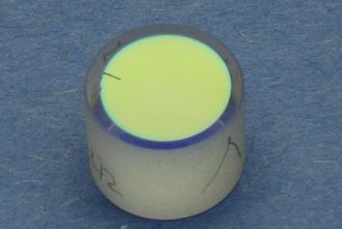
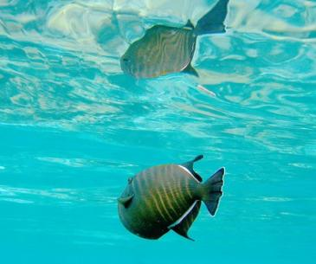
METAL REFLECTION
Three Ways to Make a Mirror
© Kyle Hounsell. All rights reserved. This content is excluded from our Creative Commons license. For more information, see http://ocw.mit.edu/fairuse
MULTILAYER REFLECTION
Image is in the public domain
Image is in the public domain:
http://en.wikipedia.org/wiki/File:Dielectric_laser_mirror_from_a_dye_laser.JPG
TOTAL INTERNAL REFLECTION

Slide 12
Dielectric Mirrors
… can be >99% reflective
Simple dielectric mirrors consist of stacked of layers of high and low refractive index. The layers are chosen such the path-length differences of reflections from low to high index layers are integer multiples of wavelengths.
Similarly, reflections from low-index layers have path length difference of half a wavelength, but add constructively because of 180 degree phase shift from the reflection. For normal incidence, these optimized thicknesses are a quarter of a wavelength
Thin layers with a high refractive index n_{HI} are interleaved with thicker layers with a lower refractive index n_{LO}.
The path lengths l_{A} and l_{B} differ by exactly one wavelength, which leads to constructive interference.
Source: wikipedia.com

Slide 13
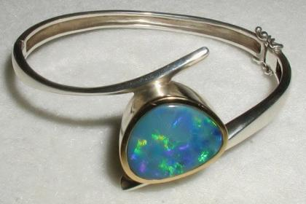
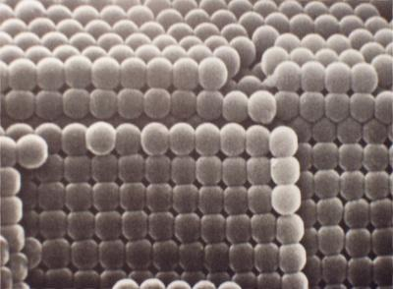
Opals
… are an example of dielectric mirrors
Colors with have
constructive interference
Image is in the public domain
Precious opal consists of spheres of silica of fairly regular size, packed into close-packed planes that are stacked together with characteristic dimensions of several hundred nm.
Incident rays
Reflected rays
Silica
spheres
© Unique Opals. All rights reserved. This content is excluded from our Creative Commons license. For more information, see http://ocw.mit.edu/fairuse.

Slide 14

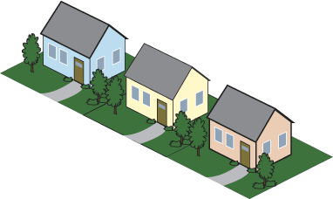




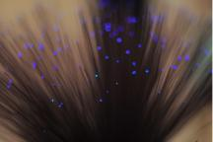
Fiber to the Home
2.4 Gbps shared by up to 128 users
Small Businesses
10-100 Mbps service rates
ONT
Splitter
2
3
2.4 Gbps out
1.2 Gbps in
Splitter
ONT
ONT
4
ONT
3
ONT
Splitter
2
ONT
1
1
4
Splitter
ONT
20 km reach
New Buried
Development
OLT
Time Division Multiplexing
Image by Dan Tentler http://www.flickr.com/
photos/vissago/4634464205/ on flickr

Slide 15
Fiber to the Home
Time Division Multiplexing
2.4 Gbps shared by up to 128 users
Small Businesses
10-100 Mbps service rates
ONT
Splitter
2
3
Splitter
ONT
ONT
2.4 Gbps out
1.2 Gbps in
ONT
4
Splitter
ONT
3
ONT
2
ONT
1
1
20 km reach
Splitter
ONT
OLT
(located in Verizon's central switching office)
4
An ONT (Optical Network Terminal) is a media converter that is installed by Verizon either outside or inside your premises, during FiOS installation. The ONT converts fiber-optic light signals to copper/electric signals. Three wavelengths of light are used between the ONT and the OLT (Optical Line Terminal):
• λ = 1310 nm voice/data transmit
• λ = 1490 nm voice/data receive
• λ = 1550 nm video receive
Each ONT is capable of delivering:
Multiple POTS (plain old telephone service) lines, Internet data, Video

Slide 16
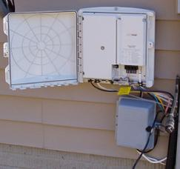
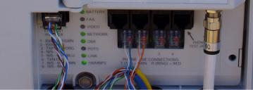



Fiber to the Home
Image by uuzinger http://www.flickr.com/photos/uuzinger/411425461/ on flickr
Image by uuzinger http://www.flickr.com/photos/uuzinger/411425452/ on flickr
Bandwidths & Services
POTS
Upstream
Downstream
ONT
1310 nm
1490 nm
1550 nm
Data
Voice and Data
Voice and Data
Video
ONT
Video
Channels downstream to each home
  λ = 1490 and λ = 1550 nm
Channel upstream from each home
  λ = 1310 nm
Power &
Battery
Image of ONT by Josh Bancroft http://www.flickr.com/photos/joshb/87167324/ on flickr

Slide 17
Passive Optical Network (PON)
Optical Assembly
TO Can Laser
TO Can PINS
Single mode
fiber
Ball lens
Thin film filters
Upstream
Downstream
Channels downstream to each home
  λ = 1490 and λ = 1550 nm
Channel upstream from each home
  λ = 1310 nm
Transmission
1310
1490
1550
Wavelength (nm)

Slide 18


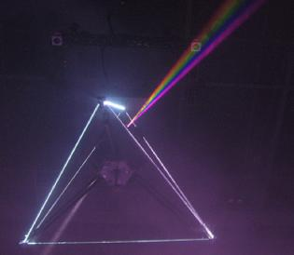

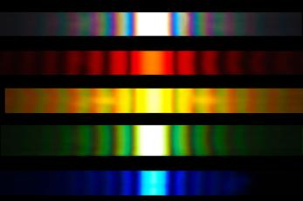

Separating Wavelengths
Dispersion
Diffraction
Image by Ian Mackenzie http://www.flickr.com/photos/madmack/136237003/
on flickr
Sunlight diffracted through a 20 μm slit
Image is in the public domain
Image by wonker http://www.flickr.com/photos/wonker/2505350820/ on flickr

Slide 19
Resonators
STANDING WAVE
RESONATORS
Terminate the standing wave with a second wall to form a resonator

Slide 20
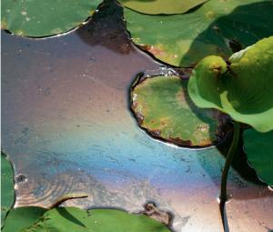







Thin Film Interference
Image by Yoko Nekonomania http://www.
flickr.com/photos/nekonomania/4827035737/
on flickr

Slide 21
Optical Resonator

Slide 22
Fabry-Perot Resonance
Transmission
Wavelength [μm]
Fabry-Perot Resonance: maximum transmission
minimum transmission

Slide 23
Total Internal Reflection
Beyond the critical angle, , a ray within the higher index medium cannot escape at shallower angles
For glass, the critical internal angle is 42°
For water, it is 49°
TOTAL INTERNAL REFLECTION
Image is in the public domain
INCOMING RAY HUGS SURFACE
42°

Slide 24



Waveguide Transport Light Between Mirrors
Metal waveguides
Dielectric waveguides
So what kind of waveguide are
the optical fibers ?
Image by Dan Tentler http://www.flickr.com/
photos/vissago/4634464205/ on flickr

Slide 25
Fabry-Perot Modes
Constructive Interference
Standing Wave E-field

Slide 26
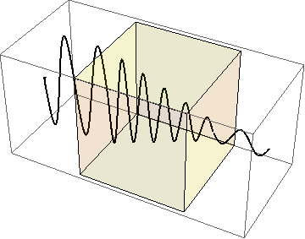
Plane Waves in Lossy Materials
1.0
0.5
0
Field strength [a.u.]
-0.5
-1.0
1
2
3
4
5
6
Propagation distance [cm]

Slide 27
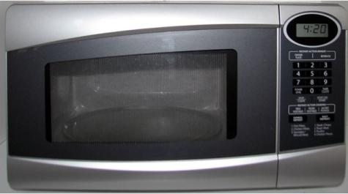
Resonators with Internal Loss
Image is in the public domain
...the EM wave loss is what heats the water inside the food

Slide 28
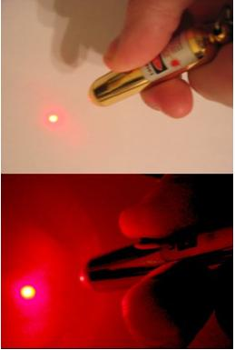
Laser Using Fabre-Perot Cavity
Resonant modes
Gain profile
Image is in the public domain

Slide 29
Resonators with Internal Gain
What if it was possible to make a material with “negative absorption”
so the field grew in magnitude as it passed through a material?
1.0
0.5
0
Field strength [a.u.]
-0.5
-1.0
1
2
3
4
5
6
Propagation distance [cm]
Resonance:

Slide 30
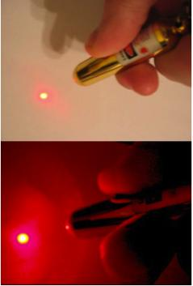
Lasers: Something for Nothing (almost)
at resonance
singularity at
Image is in the public domain

Slide 31
MIT OpenCourseWare
http://ocw.mit.edu
6.007 Electromagnetic Energy: From Motors to Lasers
Spring 2011
For information about citing these materials or our Terms of Use, visit: http://ocw.mit.edu/terms.

