Slide 1
Stored Energy and Simple Actuators
Outline
Magnetic-Field Actuators
Electric-Field Actuator

Slide 2




Energy Balance
heat
electrical
mechanical
neglect heat
For magnetostatic system, dλ/dt=0 no electrical power flow …

Slide 3


Radial Force on the Solenoid
(at a constant flux linkage, λ)
If we can find the stored energy, we can immediately compute the force…
…lets take all the things we know to put this together…
true for any single coil
true for long solenoid

Slide 4
Stored Energy in Inductors
In the absence of mechanical displacement, …
For a linear inductor:

Slide 5
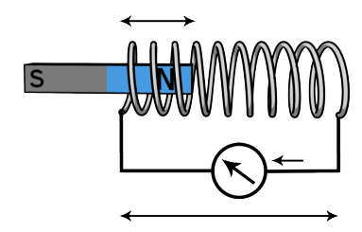
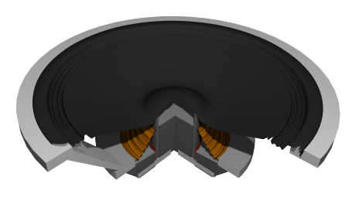


Linear Machines: Solenoid Actuator
Assuming that H outside
the solenoid is negligible
inside the solenoid
and

Slide 6
Example: Solenoid with a Core
Inductance:
Force:
THE CORE IS PULLED INTO THE SOLENOID
(FORCE ACTS TO INCREASE L)

Slide 7
Example: Differential Transformer
hot wire
neutral wire
secondary
solenoid switch
If the current in the hot wire is the same as the current in the
neutral wire, the induced current in the secondary is zero.

Slide 8
Example: Differential Transformer
hot wire
neutral wire
secondary
solenoid switch
If some current is lost,
current in the secondary opens the solenoid switch.

Slide 9
Rotational Mechanics … Motors & Generators
The translational variables x and f become
the rotational variables θ and T.
All else remains the same.

Slide 10


Rotating Machine: Variable-Reluctance Motor
+
-
Max inductance
Min inductance
THE ROTATING CORE IS PULLED INTO ALIGNMENT WITH THE STATIONARY CORE
(AGAIN, THE FORCE ACTS TO MAXIMIZE INDUCTANCE)

Slide 11

Magnetic Poetry
magnetic strontium ferrite, SrFe12O19, particles dispersed in the elastomer Hypalon
Image by Steve Johnson http://www.flickr.com/photos/artbystevejohnson/4621636807/on flickr
Field lines
Back (brown) side
Front (printed) side
Domains (arrows indicate field direction)

Slide 12





Magnetic Poetry
magnet
fridge
PRESSURE

Slide 13
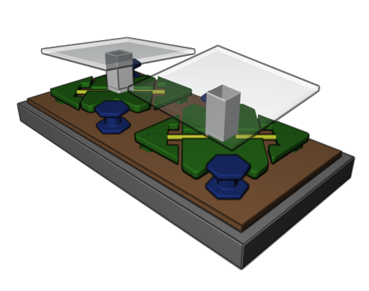
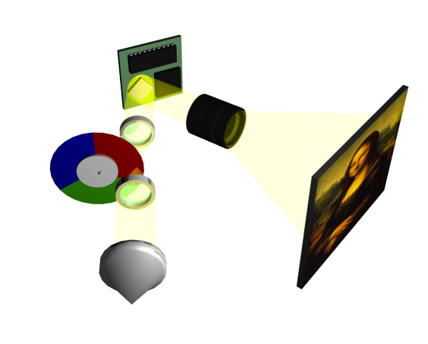
Ubiquitous
Electrostatic Motors
Hinges
Yoke
Landing Tip
DLP Board
DMD
Shaping
Lens
Projection Lens
Color filer
Condensing
lens
Screen
Light source

Slide 14
Energy Stored in
Electric Fields
Move
charges
electrode
Reference
electrode
Begin with a neutral reference conductor, the charge reservoir. Its potential is zero, by definition.
Move charges from the reference conductor into free space, thereby creating an electric field and doing work in the process. The work is stored as potential energy in the electric fields.
Account for all the work done, and thereby derive the energy stored in the electric fields.
The argument directly extends to systems with multiple conductors
(and dielectrics).
Infinity
The work done by moving charge to a location with potential is . More generally, the work done to make an incremental charge change to a charge density is
Gauss’ Law
ZERO !
ENERGY DENSITY [J/m³]

Slide 15
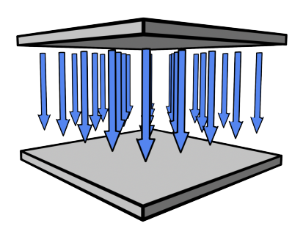
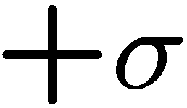

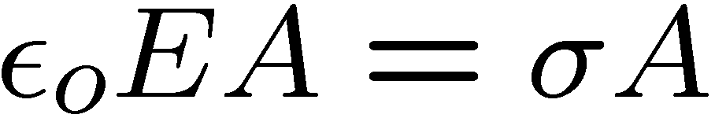





First Attempt at Estimating Forces
+
+
+
+
+
+
+
+
+
+
+
+
+
+
-
-
-
-
-
-
-
-
-
-
-
-
-
-
-
-
-
-
… this analysis is wrong ! Wrong answer ! Why?

Slide 16
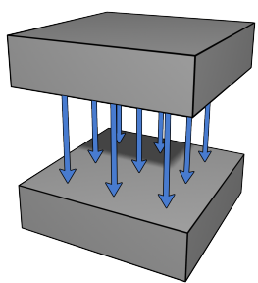
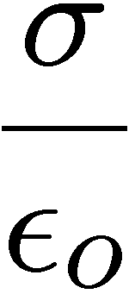

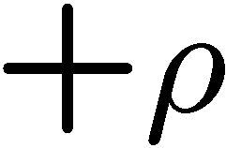


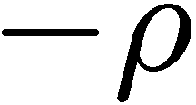
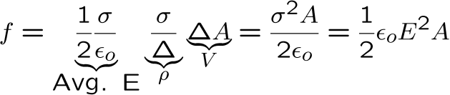
Second Try at Estimating Forces
If the capacitor plates have finite thickness,
most of the charge density doesn’t see the peak field …
+
+
+
+
+
+
+
+
+
+
+
+
+
+
+
+
+
+
+
+
+
+
+
+
+
+
+
-
-
-
-
-
-
-
-
-
-
-
-
-
-
-
-
-
-
-
-
-
-
-
-
-
-
-
-
-
-
-
-
-

Slide 17




Third Try: Use the Energy Method
Relate Stored Energy to Force
Lets use chain rule…
This looks familiar…
Comparing similar terms suggests…

Slide 18




Stored Energy of a Capacitor
… where W_{s} is energy stored in the field of the capacitor at any instant in time
Notes:
Ws = ½ CV² or Ws = ½ Q²/C

Slide 19


Third Try: Attractive Force Between Parallel Plates
+
+
+
+
+
+
+
+
+
+
+
+
+
+
-
-
-
-
-
-
-
-
-
-
-
-
-
-
-
-
-
-
CAPACITOR PLATES ARE PULLED
TOWARDS EACH OTHER
(FORCE ACTS TO INCREASE C)

Slide 20

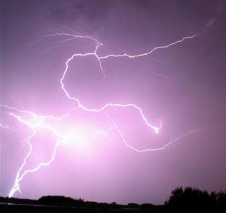



How Strong is this Force ?
The maximum electric field strength is
limited by the electrostatic breakdown
Typically…
Image by Bruce Guenter http://www.flickr.com/photos/10154402@N03/2840585154/ on flickr
For small gaps…
-
-
-
-
Electron
thermalizes
due to collisions
-
-
-
-
-
ionization
-
Notes:
4.4 N/m2 = 6e-4 psi

Slide 21
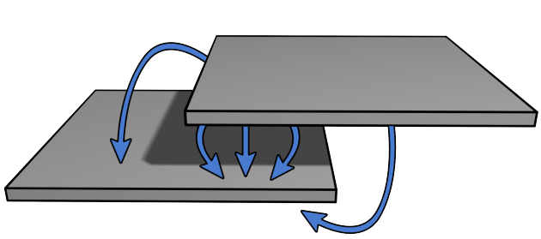



Linear Electrostatic Actuator
+
+
+
+
+
+
+
+
+
+
+
+
+
+
+
+
-
-
-
+
+
+
+
+
+
+
+
-
-
-
-
-
-
-
-
-
-
-
-
-
-
-
-
-
-
-
-
-
-
-
CONSTANT FORCE ALONG DIRECTION OF MOTION
(FORCE ACTS TO INCREASE C)

Slide 22



Gap Closing Electrostatic Actuators
Moderate force
Weak force

Slide 23

Example: Linear Comb Drive
N-fold multiplication of force …

Slide 24

1.54 Å
1.16 Å
Modeling Atoms and Molecules
as Capacitors that Store Energy
H H
H - C – C – H
H H
0.96 Å
O
H H
- -
- -
-
-
O = C = O
1.10 Å
These product molecules have shorter bond lengths than the initial reactant molecule, hence the charge in them
sits closer together. This can be
modeled as a higher capacitance.
Since voltage V = Q/C = E • d is reduced,
stored energy W/Volume = ½ ε_{o}E²
is reduced in these molecules
Burn this molecule by reacting it
with oxygen
-
5x10⁻¹¹ m
ENERGY OF AN ELECTRON IN AN ALCANE MOLECULE IN GASOLINE
+
0 V
ENERGY OF AN ELECTRON IN H₂O or CO₂
Hydrogen atom
Energy [eV]
Hydrogen ground state energy is -13.6 eV
If the hydrogen radius was twice as long, what would be the ground state energy ?
ENERGY GIVEN OFF AS HEAT IN THE PROCESS OF GASOLINE COMBUSTION
Remember this
unit of energy:
1 eV = 1.6 x 10⁻¹⁹ J

Slide 25


Electrostatic vs Magnetostatic Actuators
MAGNETIC
ELECTRIC
 | Max Field
Magnetic |  | 400 kJ/m³
Electric (Macro) |  | 4.4 J/m³
Electric (Micro) |  | 44 kJ/m³
Electric (Bio/Nano) |  | 4.4 MJ/m³
Gasoline |  | 38 GJ/m³

Slide 26

KEY TAKEAWAYS
Energy method for calculating Forces
calculated at constant flux linkage
Radial force
for an inductor
FORCE ACTS TO INCREASE INDUCTANCE, L
FORCE ACTS TO INCREASE CAPACITANCE, C
Moderate force
Weak force

Slide 27
MIT OpenCourseWare
http://ocw.mit.edu
6.007 Electromagnetic Energy: From Motors to Lasers
Spring 2011
For information about citing these materials or our Terms of Use, visit: http://ocw.mit.edu/terms.

